Slide 1
LECTURE 12
WRITING SKILLS

Slide 2
Introduction
Writing skills are an important part of communication and an important part of our lives.
organization need people who can communicate effectively both orally and in writing .You might be called upon to write a report, plan or strategy at work; write a grant Application
Some people develop writing skills as career like poets , writers , novelist etc or you may fancy communicating, your ideas online via a blog. And, of course ,a well written CV and cover letter is essential if you want a new job
Good writing skills allow you to communicate your message with clarity and ease to a far larger audience than through face-to-face or telephone conversation.

Slide 3
What is writing?
putting letters or symbols on any surface
It is a skill that allows you to express your feelings and ideas on paper, to organize knowledge and beliefs into convincing arguments, and to convey meaning through well-constructed text.

Slide 4
building blocks of written language
Text Paragraph Sentence Clause phrase word

Slide 5
1. Simple sentence-one independent clause eg Tom enjoys reading novels
Note: No commas separate compound elements (subject, direct object, subjective complement in a simple sentence
2. Compound sentence-two independent clauses joined by:
  a coordinating conjunction-for,, but, or, yet, so
  A conjunctive adverb eg however, therefore, thus
  A semicolon alone
Example
Tom reads novels, but Jack read newspapers
Tom reads novels; however, Jack reads newspapers
Tom reads novels; Jack read newspapers

Slide 6
3. Complex sentence-one independent clause (headed by a subordinating conjunction or relative pronoun) joined to an independent clause
Although Tom reads novels, Jack reads newspapers
People who read novels rarely read newspapers
Tom, who read novels, rarely reads newspapers
4. Compound-complex sentence-two independent clauses joined to one or more dependent clauses
While Tom reads novels, Jack only reads newspapers, but Allan only reads magazines

Slide 7
Writing Paragraphs

Slide 8
What is a Paragraph?
A paragraph is a group of sentences that tells about one subject or idea.
Each sentence in a paragraph must give information about the topic

Slide 9
Reasons to Write a Paragraph
1. Describe something
2. Tell a story
3. Explain something
4. To Persuade

Slide 10
Parts of a paragraph
1. Topic sentence
It is the most important sentence in a paragraph it states the main idea of a paragraph
2. Supporting sentence
Help explain the topic; supports the These are sentences that providing details, facts, examples, etc that help expound the main idea
Clincher/concluding sentence
Provide a logical conclusion based on the information provided by the supporting sentences
It is used to cement the main idea in the readers mind
It has two parts: topic and controlling idea eg
Hawassa is one of the most beautiful cities of the country

Slide 11
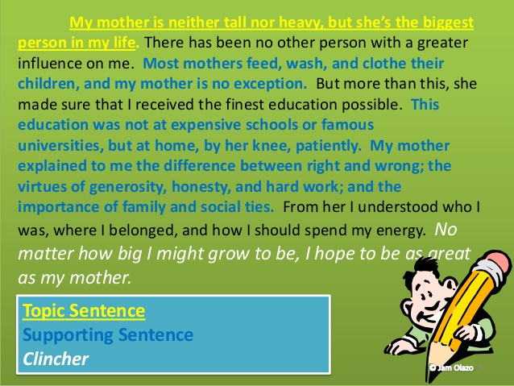

Slide 12
Qualities of a Good Paragraph
FOUR ELEMENTS
UNITY
VARIETY
COMPLETENESS
COHERENCE

Slide 13
1. Unity: all sentences in a paragraph should say about only one main idea (raised in the topic sentence)
2. Coherence: all supporting sentences should be logically arranged so that the reader can understand them easily; use transitions (cohesive words)
3. Completeness: the supporting sentences should adequately state the main idea
Sentence variety: using variety of sentences in a paragraph length(long/short); type( simple, compound, complex, compound complex)

Slide 14
STEPS OF PARAGRAPH WRITING
There are four main stages in which we have categorized paragraph writing so as to make it a lot easier for you to learn the art. The four stages of writing are:
Prewriting
Writing the First Draft
Editing and Proofreading
Writing the Final Copy (Publishing)

Slide 15
METHODS OF PARAGRAPH DEVELOPMENT
Narration
process
Description
Illustration
compare-and-contrast
cause-and-effect
definition
classification

Slide 16
NARRATION PARAGRAPH-are most frequently used in fiction and personal statements.
Narration describes the passing of time and requires, accounting for sequential order of events and chronology eg telling the reader a story. Examples:
a. Yesterday, Fatima got up at seven o’clock and took a shower. After that she had breakfast, then rode the bus to work. When she got to work, she checked her email, then discussed the new business plan with her colleagues.
b. Every Monday after class, Miguel goes to the gym and practices karate for three hours. When he has finished, he goes shopping, then takes the bus home.

Slide 17
2. PROCESS
Process means putting events in sequential or step-by-step order. In the following examples, notice how each step-by-step process also describes the passing of time.
a. When making tea, first boil water. Next, put a tea bag into a cup. When the water is boiling, pour the water into the cup. Finally, add milk and sugar as you prefer.
3. DESCRIPTION
Description creates pictures of people, places and things using adjectives and adverbs. Description appeals to the senses: smell, sight, taste, hearing and touch.
a. Alexander, the keyboard player in the band, is wearing a black leather jacket, faded jeans and red cowboy boots.
b. The old man lived alone in an old house high on a rugged cliff overlooking a stormy sea.

Slide 18
4. ILLUSTRATION
Illustration means example or supporting illustration, eg:
a. There are many places to go for a honeymoon. For example, many newlyweds go to Hawaii.
5. COMPARE-AND-CONTRAST
Compare-and-contrast describes the differences and similarities between two or more objects, people or ideas. Compare-and-contrast also describes differences in opinion, for example:
Ivan believes that all high school students should wear school uniforms; however, Paula believes that students should have the right to choose what they want to wear.

Slide 19
6. CAUSE-AND-EFFECT
Cause-and-effect means action and result. We use cause-and-effect to describe an action and the results, or consequences, of that action eg
Mohammed studied hard and got a high TOEFL score.
7. DEFINITION
A definition is a detailed description of a person, place, object or idea. The purpose of a definition is to give meaning, eg:
TOEFL is an English language proficiency test developed and implemented by Educational Testing Services (ETS) located in Princeton, New Jersey.

Slide 20
8. CLASSIFICATION
To classify means to put people, things or ideas into sub groups under a main topic, for example:
a. There are three kinds of wine: red, white and rosé.
b. TOEFL, TOEIC and IELTS are English language proficiency tests.
9. ANALOGY
Analogy provides a method of comparing a subject to something else familiar to the audience. It gives examples of similar circumstances/conditions/contexts/concepts, for example: a. For an employee, Eliminating from work is similar to losing a limb.
c. Life is like a ladder – while one goes up, the other goes down.

Slide 21
TYPES OF PARAGRAPH
There are many types of paragraphs. These are:
  Expository
  descriptive
  Narrative
  Definition
  argumentative

Slide 22
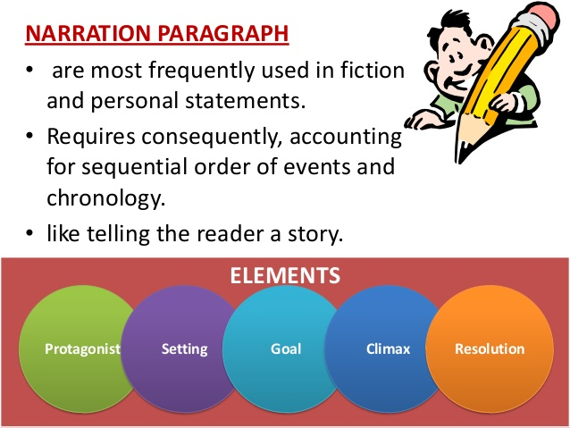

Slide 23
Method of narrative Paragraph Development
-The topic sentence in narrative paragraph sets the scene, captures the reader’s attention or sets the story in motion.
- The supporting sentences then tell the story. – these are events that make up the story.
- The concluding sentence gives the outcome of the story.

Slide 24
Paragraph Organization Method
Use of chronological order and transitions to organize your narrative.
-The events that make up the story are usually presented in the order in which they happened. (This is called chronological order.)
- Writers use transition words and phrases to help readers understand the time order of events.
Choose point of view- the person whose “voice” is telling the story in the narrative writing is called the narrator.
It can be the first or third person narrator.
Use first person point of view if you are a character in the story.
Use third person point of view if you are reporting what happened to others.
Tense
Usually past simple tense is used

Slide 25
Expository Paragraph
explains or informs ideas, object or phenomenon.
It explains, analyzes, defines, compare and illustrate. It answers questions like What? Why? How? What was the cause? The effect? Like what? Unlike what? It is also the kind of paragraph we write in reports or term papers or tests.
It can list facts, show cause and effect, compare and contrast, explain instructions/processes or gives sets of directions.
Examples of expository paragraph

Slide 26
1. Topic sentence: Rehearsing an orchestra is a painstaking process.
Question raised: What is this process?
Way to explain: Steps in a process
Topic sentence: Every symphony orchestra has four main groups of musical
instruments.
Question raised: What are the four groups?
Way to explain: Analysis
3. Topic sentence: There are many different types of plants.
Question raised: What makes one type different from the other?
Way to explain: Classification
Based on these, we can use the following methods of paragraph development.
Facts and examples(exemplification or illustration)
Steps in a process
Set of directions
Definition

Slide 27
Descriptive Paragraph
A descriptive paragraph paints a vivid picture of a person, an object or a scene
Types of Description
Objective – reports accurate appearance of the thing being described /without writers impression/
Impressionistic - the writer adds his/her own feeling, opinion and impression.
The impression can be either +ve or -ve
+ve overall impression eg The sun glowed outside, inviting everyone indoors to leave what they were doing.
-ve overall impression eg The sun fell in burning streaks though the trees, disturbing all who had no choice but to be in the streets.
The topic sentence of a descriptive paragraph will depend on the writer’s overall impression of the subject.
C. Scientific - characterized by its objectivity, clarity and precision.

Slide 28
Methods of descriptive paragraph Development
Sensory details and figurative language
Spatial order
Compare and contrast (if you are describing two cars)
Examples of Descriptive Paragraph
☺ Describing a person
☺ Describing a scene (place)

Slide 29
Argumentative Paragraph
An argumentative paragraph states an opinion and uses facts, examples, reasons, and the opinions of expects to convince readers.
- Purpose of argumentative writing is to share your view to readers (to convert the reader to writer’s way of thinking).
- The challenge of persuasive writing is to win your readers over to your way of thinking.
Argumentative Paragraph Development Method
The topic sentence in an argumentative paragraph asserts opinion, not fact. The supporting sentences back up the opinion. The most reliable kinds of support are:
-facts
-example
-reasons
-experts ‘opinion on the subject

Slide 30
ESSAY WRITING
What is an essay?
  is a relatively short composition.
  a group of paragraphs that presents one main idea.
Sections (structure) of an essay
A well-written essay has three major parts:
introductory paragraph
body of paragraphs and
concluding paragraph.

Slide 31
Introductory paragraph
The purpose of the introduction is to let the reader know
a) The topic
b) The aspect of the topic being dealt with
c) The stand (attitude) taken by the writer to the topic.

Slide 32
A good introduction
  Opening sentences introducing to the topic of the essay
  Background information on it (gradually leading to the analyzed aspect of the theme).
  Literature techniques to grab the reader’s attention.
  A strong thesis statement defining and stating the point the author is making in the essay, the paper’s main argument.
  Introduction of any essay should be no longer than 1/10 of its length.
  The content of an introduction has a deductive nature, as it leads the reader from the general views or positions on the analyzed topics to the specific narrow theme of the essay.

Slide 33
How to Write an Introduction Paragraph
The introduction is the first part of your writing that the reader will see, and must capture their attention so they continue reading your work.
The introduction of any piece of writing is integral because it summarizes what the writer will say in his writing, and because it captures the attention of the reader and encourages the reader to continue reading.
The Elements of the Introduction
The introduction should include a few different elements, all of which help to capture the attention of the reader:
A hook sentence
A basic explanation of the topic
A “menu” of the points or arguments
A thesis statement

Slide 34
The Hook- this is the first sentence in the introduction, and is what captures the reader’s attention right away. It must be interesting, but should also be general. example of a good hook in an introduction paragraph about Romeo and Juliet would be:
“The theme of disobedience towards parents by teenagers is universal, and is apparent even in the artistic works of the 1400s.”
The Explanation -summarizes what the writing is about in a sentence
“This theme is clearly shown in Shakespeare’s work, Romeo and Juliet, as an ancient feud between their families forbids them from loving each other. They go against their parent’s wishes, and pay with their lives.”

Slide 35
The Menu-explains what points (or arguments) that are going to be made in the rest of the writing. It should basically list, in sentence form, the points and a short explanation of the proofs or further information for each point: example:
“Both Romeo and Juliet are irresponsible, because they did not listen to the advice given to them by their respective advisors, Friar Lawrence and the Nurse. Also, both characters continued to see each other, and married each other behind their parent’s backs. Their actions led to the deaths of Mercutio, a friend of Romeo’s, and Tybalt, Juliet’s cousin.”

Slide 36
The Thesis Statement
The thesis statement is the last sentence of the introduction paragraph, and states definitively the position that the piece takes on the topic. It is the most specific part of the introduction. For example:
“For these reasons, the characters of Romeo and Juliet in Shakespeare’s Romeo and Juliet are irresponsible.”
Short and sweet, that’s what a thesis statement should generally look like.

Slide 37
Body paragraphs
The body will typically consist of about three paragraphs, presenting points to support your argument.
You will have worked out your ideas in the planning stage, when organizing your ideas. Now it is simply a matter of presenting one main point in each paragraph.
The body of a basic essay may have as many body paragraphs as it is necessary to prove the author’s argument of the thesis statement.
It is vital to keep in mind that each paragraph is supposed to have one main argument to analyze and has to reveal it in one solid thought in a sentence called the topic sentence.
Therefore the number of the body paragraphs equals the amount of topic sentences.
Each body paragraph must be connected to following one with a logical link.

Slide 38
concluding paragraph
The conclusion always deals with summing up the essays arguments revealed in the topic sentences and the therefore present substantial evidence to prove the thesis statement.
It is also important to mention the importance of the general conclusion of the essay.
It is usually written in one solid paragraph.
concluding paragraph
The conclusion always deals with summing up the essays arguments revealed in the topic sentences and the therefore present substantial evidence to prove the thesis statement.
It is also important to mention the importance of the general conclusion of the essay.
It is usually written in one solid paragraph.

